Slide 1
Capstone Project
Credit Card Default Prediction - Swen Fereira

Slide 2

Table of content:
- BUSINESS UNDERSTANDING
- DATA SUMMARY
- FEATURE ANALYSIS
- EXPLORATORY DATA ANALYSIS
- DATA PREPROCESSING
- IMPLEMENTING ALGORITHMS
- CONCLUSIONS
- CHALLENGES

Slide 3
Business Understanding:
In today’s world, credit cards have become a lifeline to a lot of people. Now we know the most common issue there is in providing these kind of deals are people not being able to pay the bills. These people are what we call “defaulters”.
Credit card default happens when you have become severely delinquent on your credit card payments.Missing credit card payments once or twice does not count as a default. A payment default occurs when you fail to pay the Minimum Amount Due on the credit card for a few consecutive months.
Objective of our project is to predict which customer might default in upcoming months.
The research aims at developing a mechanism to predict the credit card default beforehand and to identify the potential customer base that can be offered various credit instruments so as to invite minimum default.

Slide 4
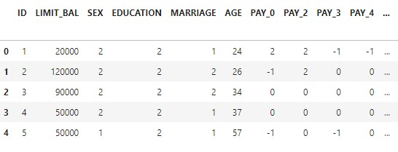
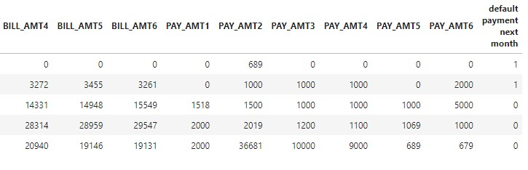
DATA Overview:

Slide 5
FEATURE SUMMARY:
● X1 -Amount of credit(includes individual as well as family credit)
● X2 -Gender
● X3 -Education
● X4 -Marital Status
● X5 -Age
● X6 to X11 -History of past payments from April to September
● X12 to X17 -Amount of bill statement from April to September
● X18 to X23 -Amount of previous payment from April to September
● Y -Default payment

Slide 6
INSIGHTS FROM OUR DATASET:
● This Dataset is from Taiwan.
● In our data set there are 30000 rows, 26 columns
● There are No Missing Values present
● There are No Duplicate values present
● There are No null values.
● And finally we have 'default payment next month' variable which we need to
predict for new observations
● 9 Categorical variables present.
● 6 Months payment and bill data available.
● The Columns are: - 'ID', 'LIMIT_BAL', 'SEX', 'EDUCATION', 'MARRIAGE', 'AGE', 'PAY_0', 'PAY_2', 'PAY_3', 'PAY_4', 'PAY_5', 'PAY_6', 'BILL_AMT1', 'BILL_AMT2', 'BILL_AMT3', 'BILL_AMT4', 'BILL_AMT5', 'BILL_AMT6', 'PAY_AMT1', 'PAY_AMT2', 'PAY_AMT3', 'PAY_AMT4', 'PAY_AMT5', 'PAY_AMT6', 'defaulters', 'AGE_BIN'

Slide 7
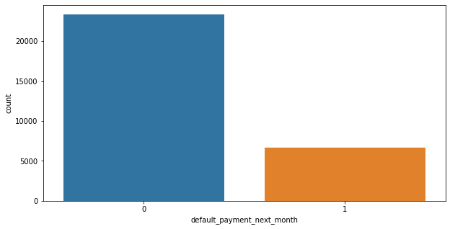
ANALYSIS OF DEPENDENT VARIABLE:
● As we can see from above graph
that both classes are not in
proportion and we have imbalanced
dataset. we need to do normalize
the data in next step..
● 0 - Not Default [23364]
● 1 - Defaut [6636]

Slide 8
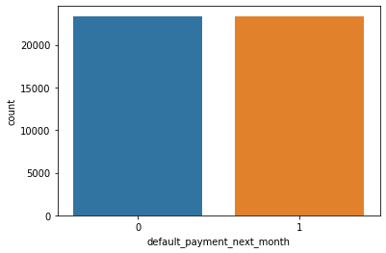
SMOTE:
● SMOTE (Synthetic Minority Oversampling
Technique) – Oversampling is one of the most
commonly used oversampling methods to solve
the imbalance problem. It aims to balance class
distribution by randomly increasing minority class
examples by replicating them.
● After performing SMOTE operation we get this
balance dataset

Slide 9
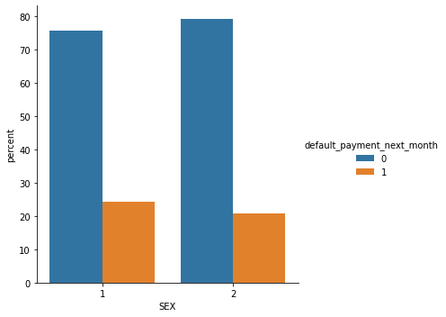
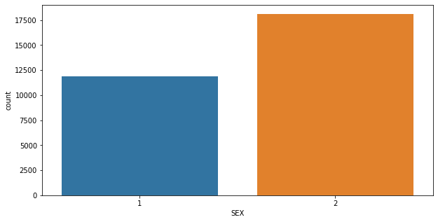
ANALYSIS OF SEX VARIABLE:
● Number of Male credit holder is less
than Female.
● It is evident from the above graph that the
number of defaulter have high proportion
of males
● 1 - Male
2 - Female
● 0 - Not Default
1 - Defaut

Slide 10
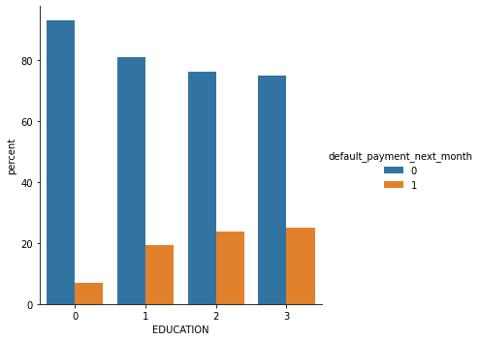
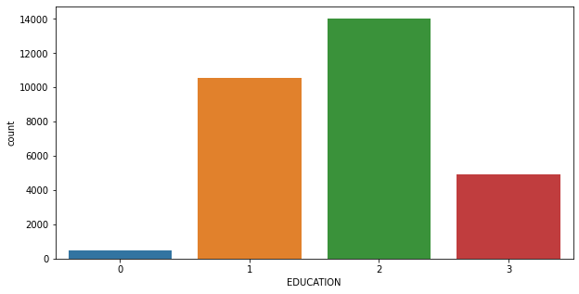
ANALYSIS OF EDUCATION VARIABLE:
● More number of credit holders are university students followed by Graduates and then High school students.
● From the right side plot it is clear that those people who are other students have higher default payment wrt graduates and university people
● 1=graduate school
2=university
3=high school
0=others
● 0 - Not Default
1 - Defaut

Slide 11
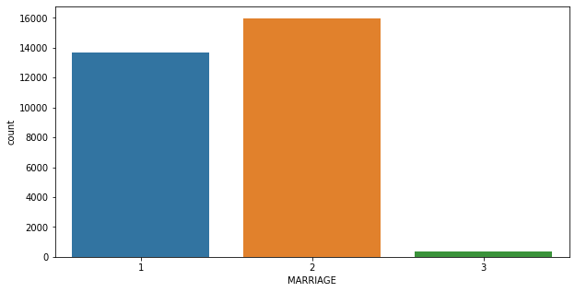
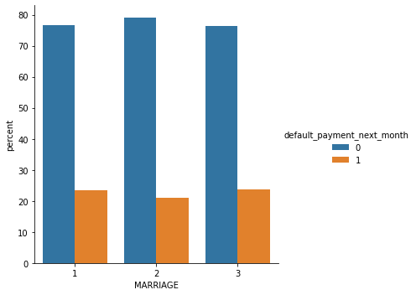
ANALYSIS OF MARRIAGE VARIABLE:
● More number of credit cards holder are Single.
● High defaulter rate when it comes to others
● 1 - married
2 - single
3 - others
● 0 - Not Default
1 - Defaut

Slide 12
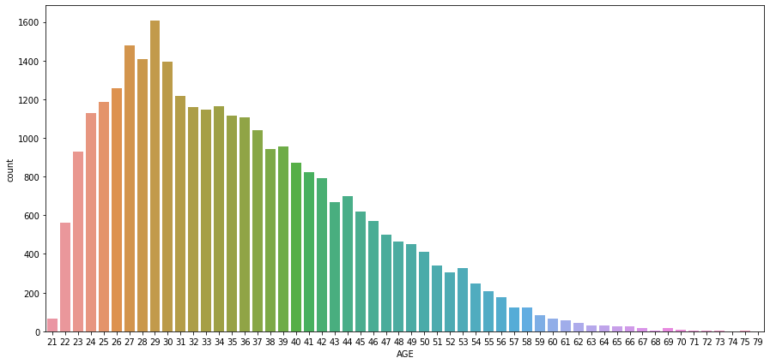
ANALYSIS OF AGE VARIABLE:
● We can see more number of credit cards holder age are between 26-30 years old.
● Age above 60 years old rarely uses the credit card.

Slide 13
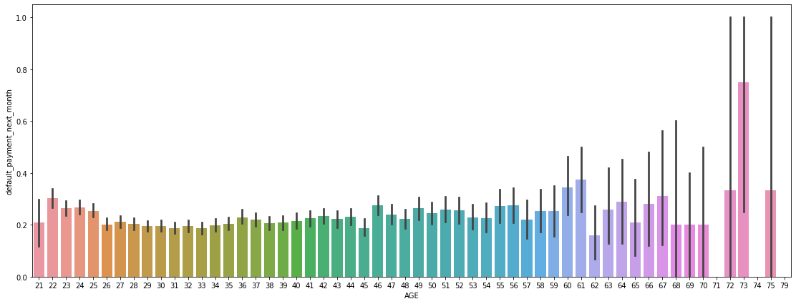
ANALYSIS OF AGE VARIABLE:
● Slightly higher defaulter rate in 60's.

Slide 14
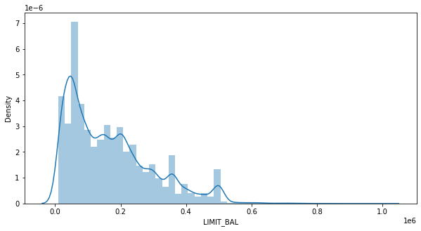
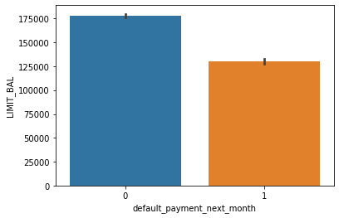
ANALYSIS OF LIMIT BALANCE VARIABLE:
● Maximum amount of given credit in NT dollars is 50,000 followed by 30,000 and 20,000.

Slide 15
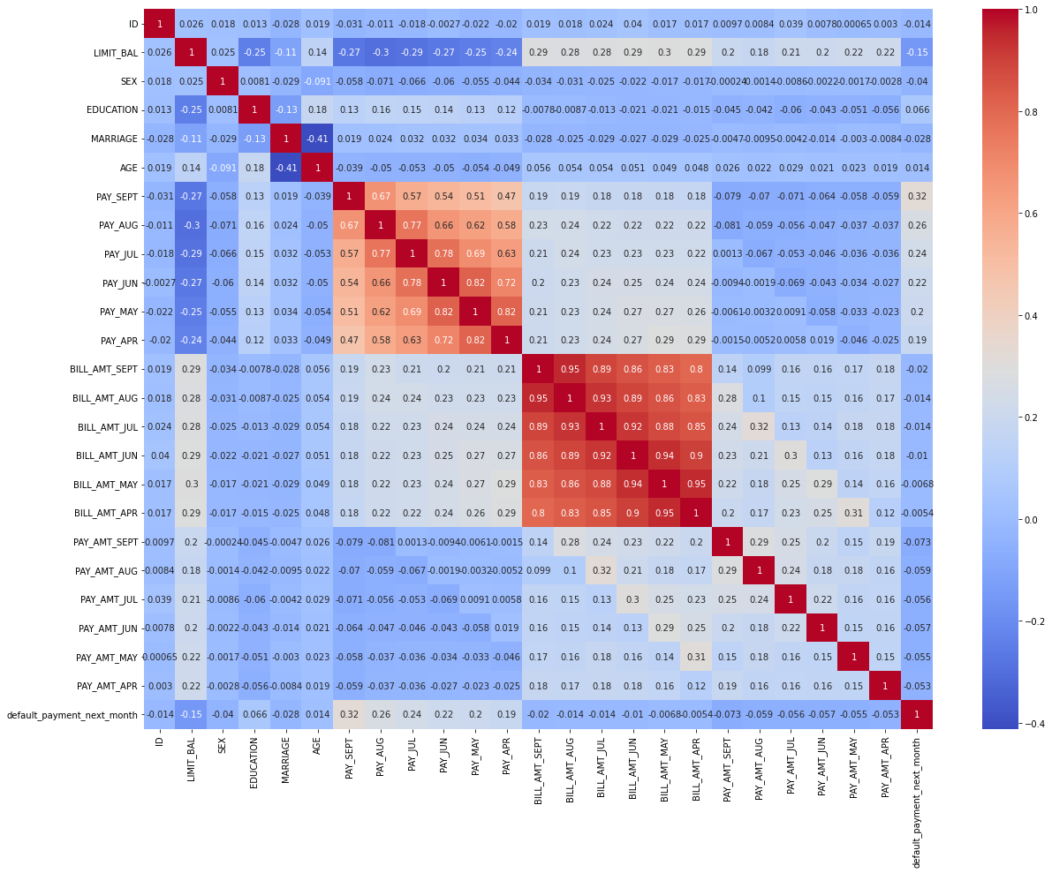
CHECKING OF CORRELATION:

Slide 16
ONE HOT ENCODING:
● One hot encoding is a process by which categorical variables are converted
into a form that could be provided to ML algorithms to do a better job in
prediction.
● Here we perform one hot encoding on
'EDUCATION','MARRIAGE','PAY_SEPT', 'PAY_AUG', 'PAY_JUL', 'PAY_JUN’,
'PAY_MAY', 'PAY_APR’
● Label encoding for ‘SEX’
● After this we get these features in our dataset:
(['LIMIT_BAL', 'SEX', 'AGE', 'BILL_AMT_SEPT', 'BILL_AMT_AUG','BILL_AMT_JUL', 'BILL_AMT_JUN', 'BILL_AMT_MAY', 'BILL_AMT_APR','PAY_AMT_SEPT', 'PAY_AMT_AUG', 'PAY_AMT_JUL', 'PAY_AMT_JUN','PAY_AMT_MAY', 'PAY_AMT_APR', 'default_payment_next_month','total_Payement_Value', 'Dues', 'EDUCATION_graduate school','EDUCATION_high school', 'EDUCATION_others', 'EDUCATION_university','MARRIAGE_married', 'MARRIAGE_others', 'MARRIAGE_single', 'PAY_SEPT_-1','PAY_SEPT_0', 'PAY_SEPT_1', 'PAY_SEPT_2', 'PAY_SEPT_3', 'PAY_SEPT_4','PAY_SEPT_5', 'PAY_SEPT_6', 'PAY_SEPT_7', 'PAY_SEPT_8', 'PAY_AUG_-1','PAY_AUG_0', 'PAY_AUG_1', 'PAY_AUG_2', 'PAY_AUG_3', 'PAY_AUG_4','PAY_AUG_5', 'PAY_AUG_6', 'PAY_AUG_7', 'PAY_AUG_8', 'PAY_JUL_-1','PAY_JUL_0', 'PAY_JUL_1', 'PAY_JUL_2', 'PAY_JUL_3', 'PAY_JUL_4','PAY_JUL_5', 'PAY_JUL_6', 'PAY_JUL_7', 'PAY_JUL_8', 'PAY_JUN_-1','PAY_JUN_0', 'PAY_JUN_1', 'PAY_JUN_2', 'PAY_JUN_3', 'PAY_JUN_4','PAY_JUN_5', 'PAY_JUN_6', 'PAY_JUN_7', 'PAY_JUN_8', 'PAY_MAY_-1', 'PAY_MAY_0', 'PAY_MAY_1', 'PAY_MAY_2', 'PAY_MAY_3', 'PAY_MAY_4','PAY_MAY_5', 'PAY_MAY_6', 'PAY_MAY_7', 'PAY_MAY_8', 'PAY_APR_-1','PAY_APR_0', 'PAY_APR_1', 'PAY_APR_2', 'PAY_APR_3', 'PAY_APR_4','PAY_APR_5', 'PAY_APR_6', 'PAY_APR_7', 'PAY_APR_8']

Slide 17

MODEL BUILDING:
➢ LOGISTIC REGRESSION
➢ RANDOM FOREST
➢ SVC
➢ XGBOOST

Slide 18
LOGISTIC REGRESSION:
The accuracy on test data is 0.7503404448479346 -The precision on test data is 0.6848249027237354
The recall on test data is 0.7880597014925373
The f1 on test data is 0.7328244274809161
The roc_score on test data is 0.7547109652973523

Slide 19
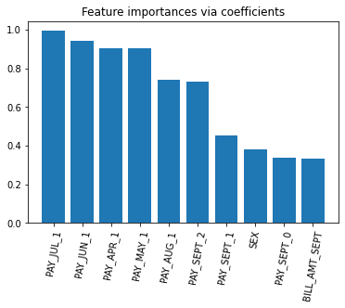
FEATURE IMPORTANCE:
● The most important feature that make an impact on dependt variable are
PAY_JUL_1, PAY_JUN_1 & PAY_APR_1.

Slide 20
RANDOM FOREST:
The accuracy on test data is 0.8354840801504442
The precision on test data is 0.8051880674448768
The recall on test data is 0.8571034101891482
The f1 on test data is 0.8303350498227781
The roc_score on test data is 0.8367199613919574

Slide 21
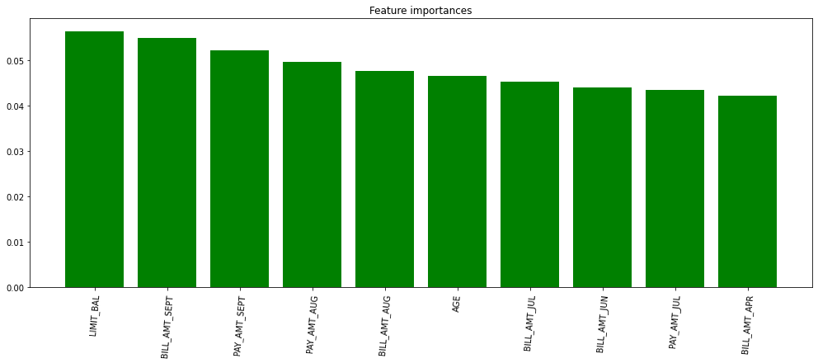
FEATURE IMPORTANCE:
● The most important feature that make an impact on dependt variable are
LIMIT_BAL,PAY_AMT_SEPT

Slide 22
SUPPORT VECTOR CLASSIFIER (SVC):
The accuracy on test data is 0.7773814927695999
The precision on test data is 0.7158236057068742
The recall on test data is 0.8162993639994084
The f1 on test data is 0.762766913136618
The roc_score on test data is 0.7816485272652931

Slide 23
XGBOOST:
The accuracy on test data is 0.8293236495687698
The precision on test data is 0.7920881971465629
The recall on test data is 0.8558015695067265
The f1 on test data is 0.8227131887377072
The roc_score on train data is 0.8311596863828141

Slide 24
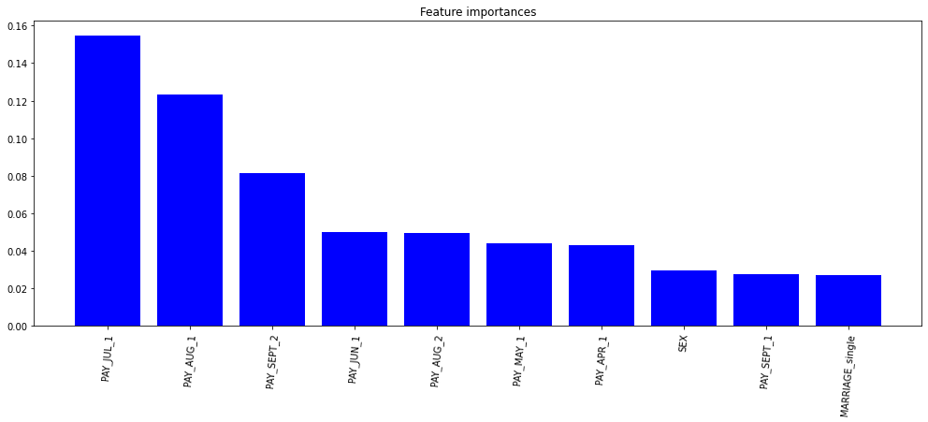
FEATURE IMPORTANCE:
The most important feature that make an impact on dependt variable are PAY_JULY_1.

Slide 25
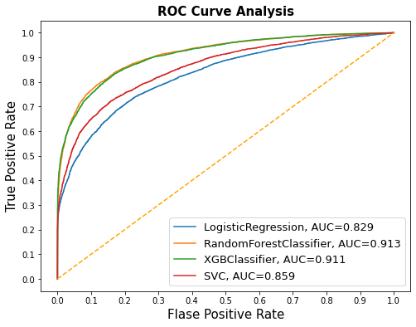
AUC-ROC CURVE COMPARISON:

Slide 26
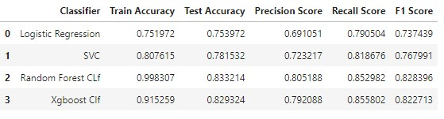
EVALUATING THE MODELS:
Xgboost classifier perform best among those models.

Slide 27
CONCLUSION:
➢ Recent 2 months payment status and credit limit are the strongest default predictors.
➢ Recall is the best accuracy metrics here, because if the algorithm will not detect the
defaulters, that will encounter more loss to the bank.
➢ XGBoost provided us the best results giving us a recall of 85% percent(meaning out of
100 defaulters 85 will be correctly caught by XGBoost)
➢ Random Forest also had good score as well but leads to overfit the data.
➢ Logistic regression being the least accurate with a recall of 79%.
➢ Higher recall can be achieved if low precision is acceptable.
➢ This Model can only be served as an aid in decision making instead of replacing human
decision.
➢ Model can be improved with more data and computational resources.

Slide 28
CHALLENGES:
➢ Large dataset to handle
➢ Feature Analysis
➢ Need to Remove outliers
➢ Feature engineering
➢ Getting a higher accuracy on the models.
➢ Carefully handled feature imbalanced data
➢ Carefully tuned Hyperparameters

Slide 29

This Photo by Unknown Author is licensed under CC BY-NC-ND

